Slide 1
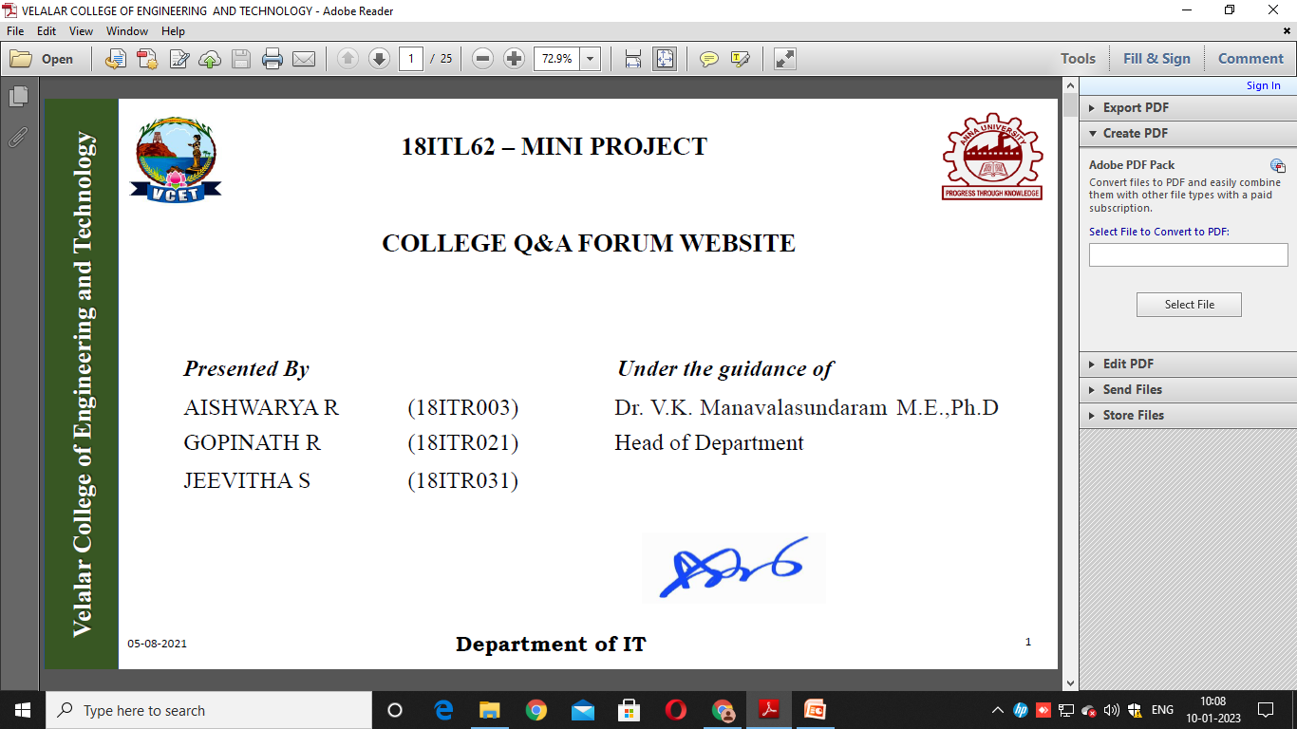
Velalar College of Engineering and Technology
18ITL81- MAIN PROJECT
CLASSIFICATION OF ALZHEIMER’S DISEASE AND ITS STAGES USING MACHINE LEARNING
Presented by,
MULLAIVENTHAN N (19ITR065)
SHANMUGAAPRIYAA S (19ITR096)
SHARUKKHAN R I (19ITR098)
VINITHA S (19ITR122)
Under the Guidance of
Ms. PREMA P, M.E.,

Slide 2
ABSTRACT
Velalar College of Engineering and Technology
Deep learning, a state-of-the-art machine learning approach, has shown outstanding performance over traditional machine learning in identifying intricate structures in complex high-dimensional data, especially in the domain of computer vision.
The application of deep learning to early detection and automated classification of Alzheimer's disease (AD) has recently gained considerable attention, as rapid progress in neuroimaging techniques has generated large-scale multimodal neuroimaging data.
Alzheimer is one of the types of Dementia. It is a brain disorder disease. So we focus on this disease and they are trying to control the disease with various techniques.

Slide 3
Velalar College of Engineering and Technology
LITERATURE SURVEY
Validation of a Regression Technique for Segmentation of White Matter Hyper intensities in Alzheimer’s disease
Mahsa Dadar et al (2017): Segmentation and volumetric quantification of white matter hyper intensities is essential in assessment and monitoring of the vascular burden in aging and Alzheimer's disease (AD), especially when considering their effect on cognition.
Manually segmenting WMHs in large cohorts is technically unfeasible due to time and accuracy concerns. Automated tools that can detect WMHs robustly and with high accuracy are needed. A fully automatic technique for segmentation and volumetric quantification of WMHs in aging and AD.

Slide 4
Velalar College of Engineering and Technology
CONT.,
Studying the Manifold Structure of Alzheimer's Disease: A Deep Learning Approach Using Convolutional Auto encoders
Francisco J. Martinez-Murcia et al (2019): Many classical machine learning techniques have been used to explore Alzheimer's disease (AD), evolving from image decomposition techniques such as principal component analysis toward higher complexity, non-linear decomposition algorithms.
With the arrival of the deep learning paradigm, it has become possible to extract high-level abstract features directly from MRI images that internally describe the distribution of data in low-dimensional manifolds.

Slide 5
Velalar College of Engineering and Technology
CONT.,
Modeling Disease Progression via Multisource Multitask Learners: A Case Study With Alzheimer’s Disease
Liqiang Nie et al (2016): Understanding the progression of chronic diseases can empower the sufferers in taking proactive care. To predict the disease status in the future time points, various machine learning approaches have been proposed.
However, a few of them jointly consider the dual heterogeneities of chronic disease progression. In particular, the predicting task at each time point has features from multiple sources, and multiple tasks are related to each other in chronological order.

Slide 6
Velalar College of Engineering and Technology
CONT.,
Latent Representation Learning for Alzheimer’s disease Diagnosis with Incomplete Multi-Modality Neuroimaging and Genetic Data
Tao Zhou et al (2019): The fusion of complementary information contained in multi-modality data [e.g., magnetic resonance imaging (MRI), positron emission tomography (PET), and genetic data] has advanced the progress of automated Alzheimer's disease (AD) diagnosis.
However, multi-modality based AD diagnostic models are often hindered by the missing data, i.e., not all the subjects have complete multi-modality data.
One simple solution used by many previous studies is to discard samples with missing modalities. However, this significantly reduces the number of training samples, thus leading to a sub-optimal classification model.

Slide 7
Velalar College of Engineering and Technology
CONT.,
Modeling Disease Progression via Multisource Multitask Learners: A Case Study With Alzheimer’s Disease
LiqiangNie et al (2016): Understanding the progression of chronic diseases can empower the sufferers in taking proactive care. To predict the disease status in the future time points, various machine learning approaches have been proposed.
However, a few of them jointly consider the dual heterogeneities of chronic disease progression. In particular, the predicting task at each time point has features from multiple sources, and multiple tasks are related to each other in chronological order.

Slide 8
EXISTING SYSTEM
Velalar College of Engineering and Technology
The existing system is to develop a method to identify potential blood-based non-amyloid biomarkers for early AD detection.
The use of blood is attractive because it is accessible and relatively inexpensive. Our method is mainly based on machine learning (ML) techniques (support vector machines in particular) because of their ability to create multivariable models by learning patterns from complex data. Using novel feature selection and evaluation modalities we identified 5 novel panels of non-amyloid proteins with the potential to serve as biomarkers of early AD.

Slide 9
DRAWBACKS
Velalar College of Engineering and Technology
Disease cannot Classified by the SVM
It cannot find accurate Results
Pre-processing result is crucial for the pre-detection
Time complexity
Not efficient for the extracting the features.

Slide 10
PROPOSED SYSTEM
Velalar College of Engineering and Technology
Application of Deep Learning techniques coupled with radiological imaging can be helpful in the accurate identification of this disease, and can also be supportive in overcoming the issue of a shortage of trained physicians in remote communities.
A CNN with ResNet 50 is a kind of network architecture for deep learning algorithms and is specifically used for image recognition and tasks that involve the processing of pixel data
There are other types of neural networks in deep learning, but for identifying and recognizing objects, CNN with ResNet 50 are the network architecture of choice.
The Proposed algorithm of CNN, the state-of-the-art convolutional neural network algorithm for object detection and segmentation to the oral pathology domain. CNN with ResNet 50 is originally developed for disease detection, and object instance segmentation of natural images.
With this experiment, that CNN with ResNet 50 can also be used in a very specialized area such as oral pathology.

Slide 11
ADVANTAGES
Velalar College of Engineering and Technology
Efficient classified the disease
Low cost
Reduce time complexity
Accurately finding the disease
Improving segmentation and Classification

Slide 12
PROPOSED ARCHITECTURE DIAGRAM
Velalar College of Engineering and Technology
Collection of Data set
Pre-Processing
Feature extraction
Alzheimer Disease OR not
CNN with ResNet 50 algorithm
Classification
Output

Slide 13
MODULES
Velalar College of Engineering and Technology
Training model
Pre-processing
Feature extraction
Epoch value generation
Classification

Slide 14
MODULES
Velalar College of Engineering and Technology
TRAINING MODEL
The training models include the trained arguments with the rotation range, width shift range, height shift range, horizontal flip. Which allows you to randomly rotate images through any degree between 0 and 360 by providing an integer value in the rotation range argument?This will integrate the rotation range, width shift range, height shift range and the horizontal shift range is also included. When the image is rotated, some pixels will move outside the image and leave an empty area that needs to be filled in.
PRE-PROCESSING
Data preprocessing can refer to manipulation or dropping of data before it is used in order to ensure or enhance performance, and is an important step in the data mining process. The phrase "garbage in, garbage out" is particularly applicable to data mining and machine learning projects. Data-gathering methods are often loosely controlled, resulting in out-of-range values, impossible data combinations, and missing values, etc., The raw data for structural for EEG reports. For our experiment we have done some preprocessing on the data. The preprocessing steps of the dataset before processing into the designed network.

Slide 15
MODULES
Velalar College of Engineering and Technology
FEATURE EXTRACTION
The feature vectors for a normal Alzheimer’s will have relatively uniform values resulting in a compact normal subspace. These feature vectors are used for learning the subspace corresponding to normal data. Feature extraction is a part of the dimensionality reduction process, in which, an initial set of the raw data is divided and reduced to more manageable groups. These features are easy to process, but still able to describe the actual data set with the accuracy and originality
EPOCH VALUE GENERATION
In a computing context, an epoch is the date and time relative to which a computer's clock and timestamp values are determined. The epoch traditionally corresponds to 0 hours, 0 minutes, and 0 seconds (00:00:00) Coordinated Universal Time (UTC) on a specific date, which varies from system to system. Based on the values the time coordination will take place in the creation of epoch value so that the trained and the test values can be generated.

Slide 16
MODULES
Velalar College of Engineering and Technology
CNN WITH RESNET 50
Demented and non demented can be able to identify in the CNN with ResNet 50 mehtod. It can process images to verify the Alzheimer disease implementing the CNN . This methods are used to evaluate the total affected the region of the Alzheimer dataset.
CLASSIFICATION
The classification technique predicts the target class for each data set point. With the help of the classification approach, a risk factor can be associated with patients by analyzing their patterns of diseases. The result will produce the 98.85%, either it is dimentiated or non dimentiated.

Slide 17
CONCLUSION
Velalar College of Engineering and Technology
A deep learning model to detect Alzheimer disease cases from Brain X-Ray images. This automated system can perform binary classification without manual feature extraction with an accuracy of 97.36%. Moreover, this model is also capable of testing with a larger dataset and work with real-time systems.
Furthermore, it can be helpful in areas where the test kit is not sufficient. Until now, there has been no recognition from the research community of medical experts for AD positive case detection from radiology images using deep learning framework. Additionally, extensive experiments on the collected and annotated esophageal cancer dataset demonstrate the effectiveness of the proposed framework, i.e.,
The improved CNN with ResNet 50 framework can segment the Alzheimer accurately and simultaneously. Since it is time consuming and laborious to label medical images, we will investigate semi-supervised and weakly supervised Brain and organ segmentation techniques in the future.

Slide 18
REFERENCES
Velalar College of Engineering and Technology
P. Jiang, X. Wang, Q. Li, L. Jin and S. Li, "Correlation-Aware Sparse and Low-Rank Constrained Multi-Task Learning for Longitudinal Analysis of Alzheimer's Disease," in IEEE Journal of Biomedical and Health Informatics, vol. 23, no. 4, pp. 1450-1456, July 2020, doi: 10.1109/JBHI.2018.2885331.
S. Minhas, A. Khanum, F. Riaz, S. A. Khan and A. Alvi, "Predicting Progression From Mild Cognitive Impairment to Alzheimer's Disease Using Autoregressive Modelling of Longitudinal and Multimodal Biomarkers," in IEEE Journal of Biomedical and Health Informatics, vol. 22, no. 3, pp. 818-825, May 2021, doi: 10.1109/JBHI.2017.2703918.
B. Lei et al., "Neuroimaging Retrieval via Adaptive Ensemble Manifold Learning for Brain Disease Diagnosis," in IEEE Journal of Biomedical and Health Informatics, vol. 23, no. 4, pp. 1661-1673, July 2019, doi: 10.1109/JBHI.2018.2872581.
R. Cui and M. Liu, "Hippocampus Analysis by Combination of 3-D DenseNet and Shapes for Alzheimer's Disease Diagnosis," in IEEE Journal of Biomedical and Health Informatics, vol. 23, no. 5, pp. 2099-2107, Sept. 2021, doi: 10.1109/JBHI.2018.2882392.
L. Brand, K. Nichols, H. Wang, L. Shen and H. Huang, "Joint Multi-Modal Longitudinal Regression and Classification for Alzheimer’s Disease Prediction," in IEEE Transactions on Medical Imaging, vol. 39, no. 6, pp. 1845-1855, June 2020, doi: 10.1109/TMI.2019.2958943.

